Slide 1
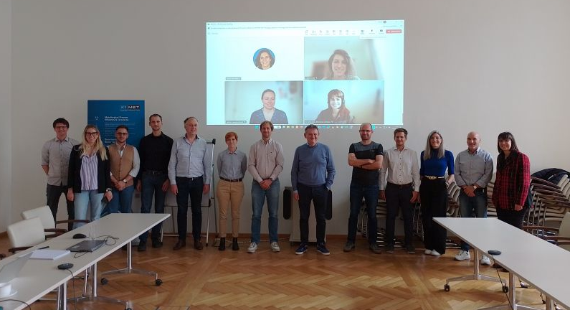
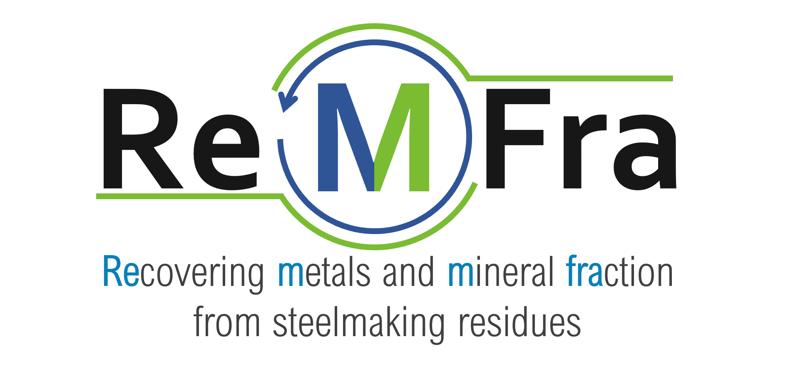
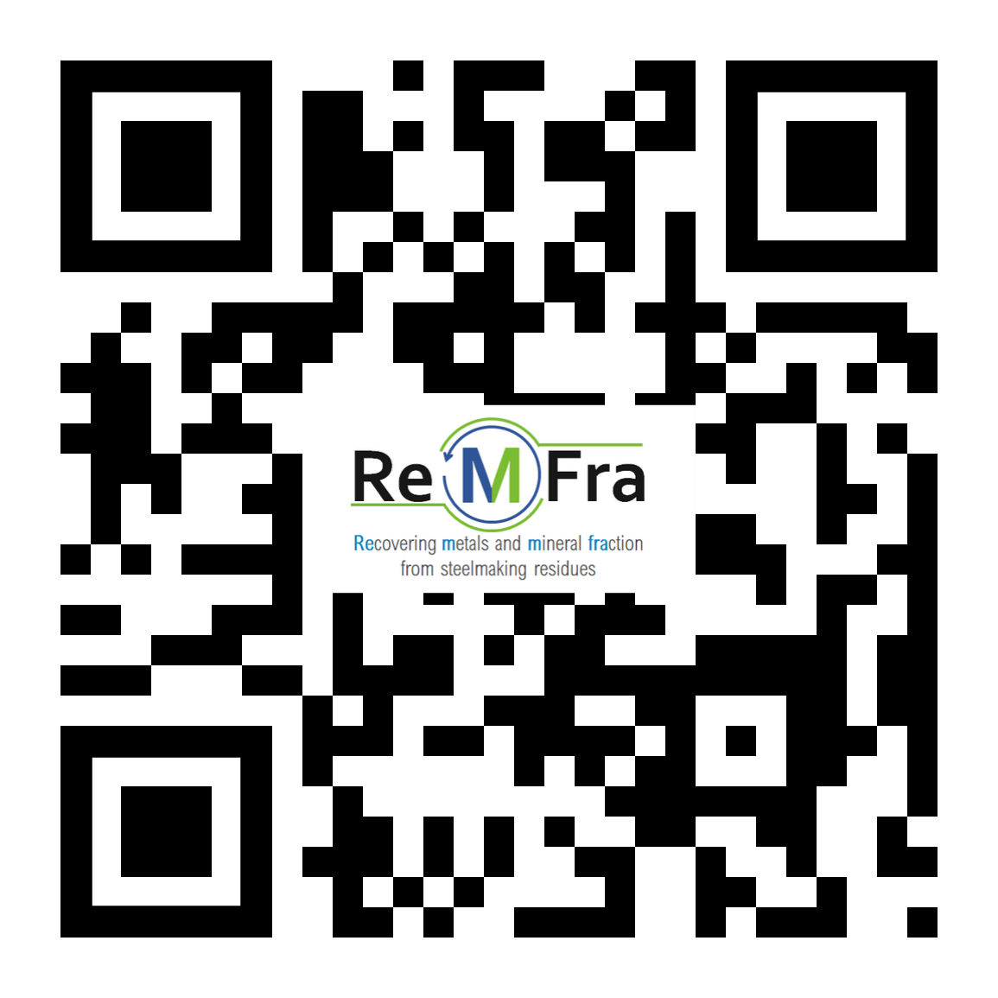

ReMFra
Newsletter # 6 December 2024
👉 4th in-person project meeting in Leoben!
📅 On October 9-10, 2024, the 4_{th} in-person #ReMFra project meeting was held at Montanuniversitaet Leoben (Austria), hosted by the Chair of Thermal Processing Technology and K1-MET GmbH.
Thanks to our colleagues Klaus Doschek-Held (Montanuniversitaet, Chair of Thermal Processing Technology) and Wolfgang Reiter for the excellent organization.
💡🤝 During the meeting, updates and discussions showed that the project is moving in the right direction.
And also thanks for the visit of the #RecoDust pilot plant and further laboratories at the Chair of Thermal Processing Technology.
Unfortunately, it was the last meeting with Mr. Fabio Praolini as meeting leader (from the coordinator Tenaris), whom we wish all the best for his well-deserved retirement! His successor is Ms. Silvia Tosato being already excellently involved in the project.

Slide 2
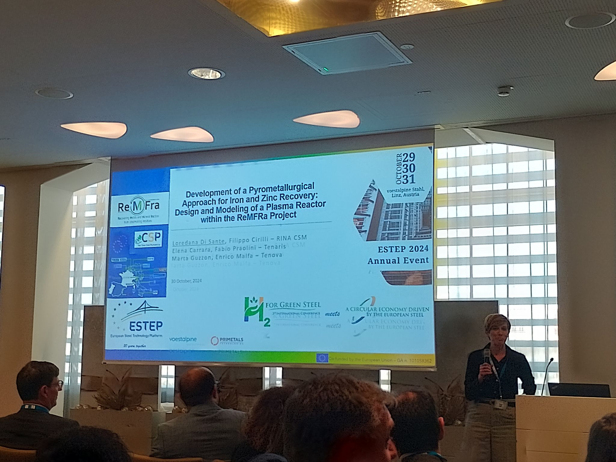
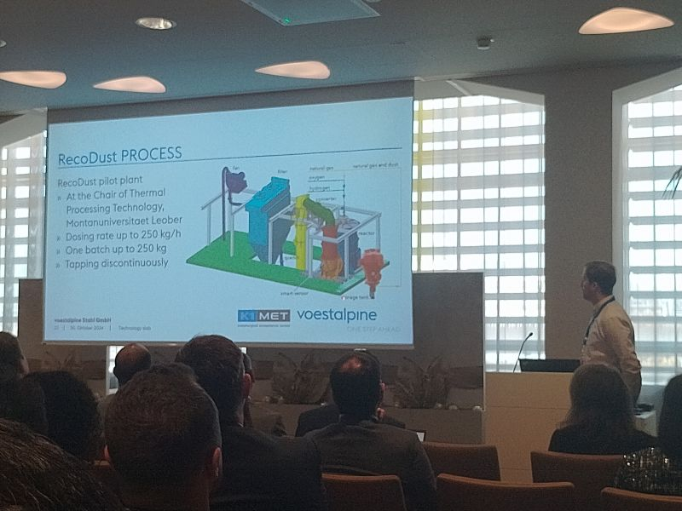
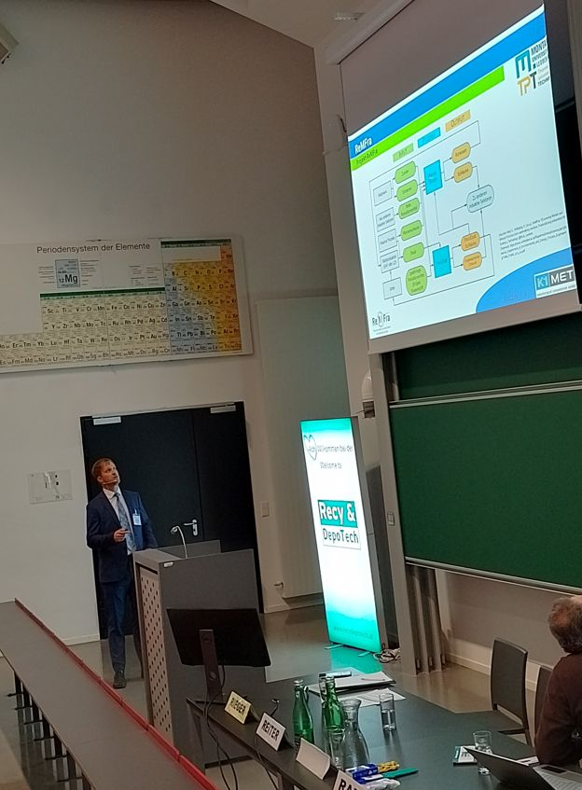
ReMFra
Newsletter # 6 December 2024
ReMFra Project Update: International Presence at ESTEP Annual Event and Recy & DepoTech 2024
The ReMFra project team has been actively engaged in showcasing its innovations and fostering collaboration on an international stage. In October and November 2024, we had the privilege of participating in two significant events: the ESTEP Annual Event 2024 and the Recy & DepoTech 2024 conference.
At the ESTEP (European Steel Technology Platform) Annual Event titled "H2 for Green Steel meets A Circular Economy driven by the European Steel“ held in Linz (Austria), Wolfgang Reiter and Christoph Thaler presented the topic "Decarbonization in the steel industry and future production routes and future utilization paths for the by-products generated“.
Additionally, Loredana Di Sante (RINA-CSM) contributed with her presentation on "Development of a pyrometallurgical approach for iron and zinc recovery: design and modeling of a plasma reactor within the ReMFra project“.
These presentations highlighted innovative strategies for reducing carbon emissions, advancing sustainable steel production, and optimizing by-product utilization through cutting-edge technologies.
At Austria’s largest conference on recycling and waste management, the Recy & DepoTech 2024 held in Leoben (Austria), Wolfgang Reiter took the stage to present "ReMFra - Recovering metals and mineral fractions from steelmaking residues“. His talk focused on the project’s efforts to develop efficient solutions for resource recovery and the circular reuse of materials, sparking engaging discussions with attendees about the future of waste reduction and resource efficiency in the steel industry.

Slide 3




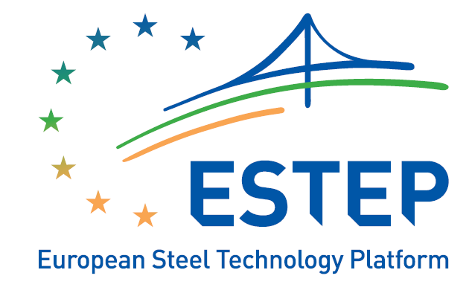
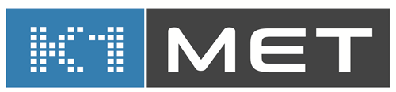

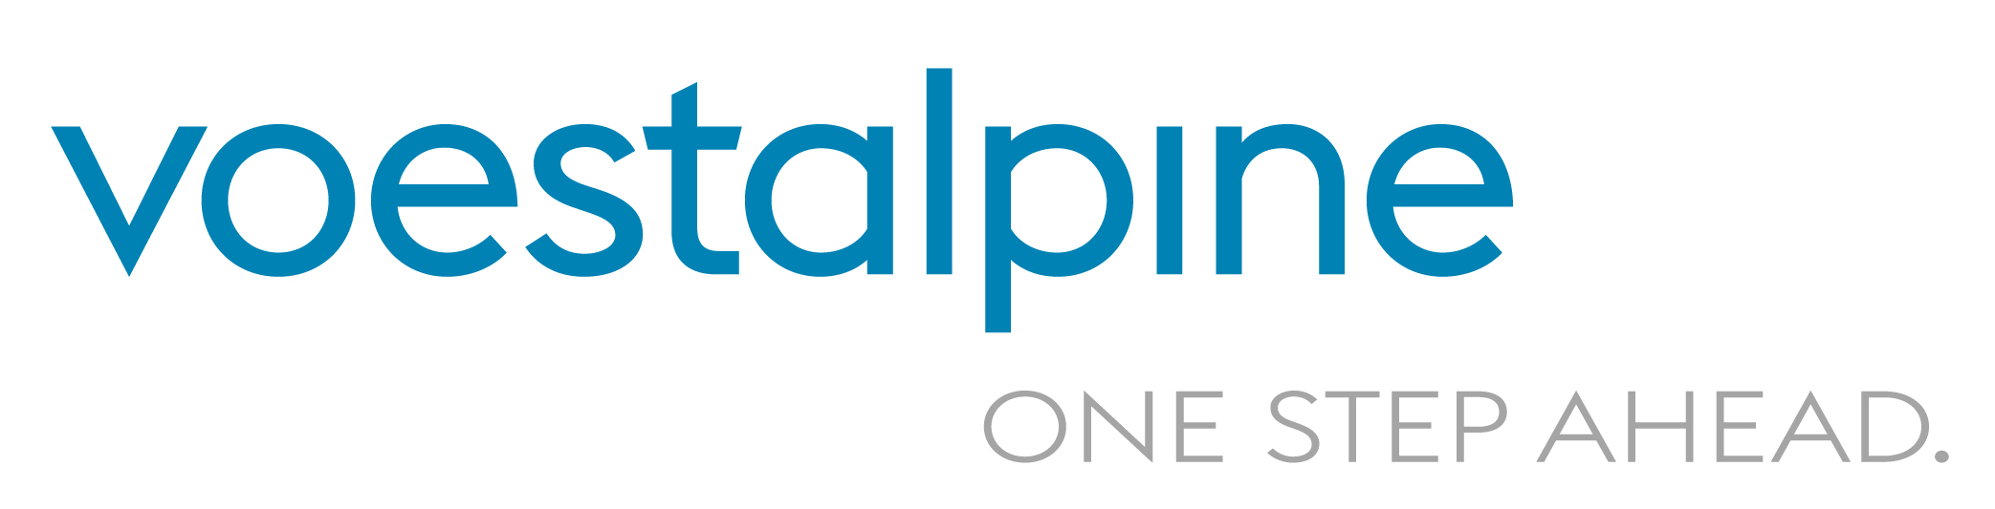




ReMFra
PROJECT PARTNERS:
Starting with the project coordinator, the consortium is composed as follows:
Tenaris Dalmine (Italy, Coordinator)
Tenova (Italy)
RINA Consulting – Centro Sviluppo Materiali (Italy)
European Steel Technology Platform (Belgium)
K1-MET (Austria)
voestalpine Stahl (Austria)
Montanuniversität Leoben, Chair of Thermal Processing Technology (Austria)
FEhS Institut fuer Baustoffforschung e.V. (Germany)
thyssenkrupp Steel Europe (Germany)
Tata Steel Netherland Technology (The Netherlands)
Barna Steel (Spain)
FUNDING SCHEME and consortium
Call: Horizon Europe Clean Steel Partnership (HORIZON-CL4-2021-TWIN-TRANSITION-01-19)
Type of action: Innovation Action (IA)
Granting authority: European Health and Digital Executive Agency
The ReMFra project receives funding by the European Union (Grant Agreement no. 101058362).
Newsletter # 6 December 2024

